Slide 1

Submitted by:-
Ashutosh Mishra
Malignant Comment Classifier

Slide 2




1.Problem Statement
3. EDA and Visualizations
5. Conclusion
4. Model Dashboard
And Finalized Model
2. Approach and Assumptions

Slide 3




Problem Statement and Understanding
Our goal is to build a prototype of online hate and abuse comment classifier which can be used to predict hate and offensive comments so that it can be controlled and restricted from spreading hatred and cyberbullying.
Libraries Explored
Motivation Behind
Statistics, Analytical Modelling
Hyper Tuning Method
CV Score
Predictive Modelling and Classification Model, etc.
Develop a holistic understanding like – use of statistics, data visualizations, analysis based on past data for better and accurate prediction, etc.
Objective
Illustration
Project comprises of six different test cases where the objective was to train and test for accuracy score and different classification reports using ROC AUC CURVE and F1-Score to understand the accuracy of the different algorithms model
Histogram Chart
Count Plot
Pearson Correlation Heat map
Distribution and Box Plot
Scatter Plot
Violin Plot

Slide 4
Background and Approach -
Classification Models
Model
Graphs
There has been a remarkable increase in the cases of cyberbullying and trolls on various social media platforms. Many celebrities and influences are facing backlashes from people and have to come across hateful and offensive comments. This can take a toll on anyone and affect them mentally leading to depression, mental illness, self-hatred and suicidal thoughts.
Being a Data Scientist, I have used the Classification Model using multiple algorithms to design and build a prototype of online hate and abuse comment classifier so that it can be controlled and restricted from spreading hatred and cyberbullying.
Mathematical Modelling
Analytical Modelling
CV Score
Principle Component Analysis
Hyper Tuning Method
Grid Search CV

Slide 5
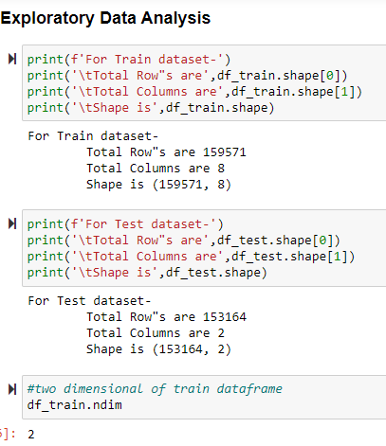
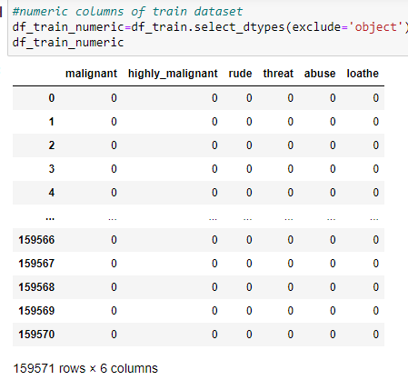
Exploratory Data Analysis

Slide 6
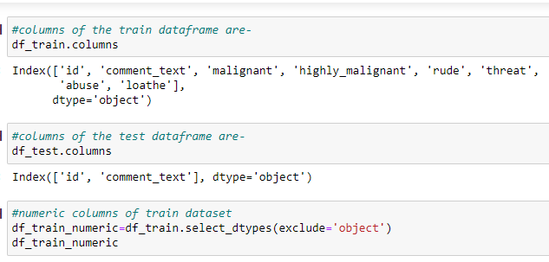
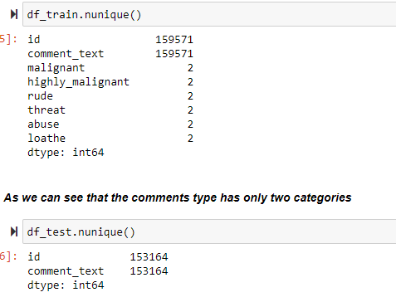
Exploratory Data Analysis

Slide 7
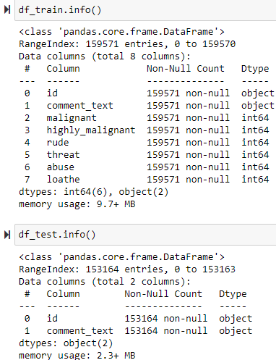
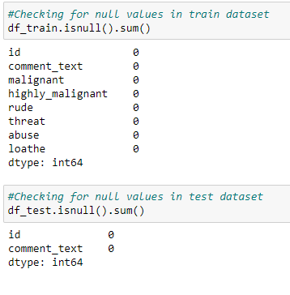
Exploratory Data Analysis

Slide 8
Exploratory Data Analysis
With the help of exploratory data analysis we basically analyze the different data sets and summarize their main characteristics by using statistical graphics and other data visualization graphs.
There are no null value present within the data set.
There are two categorical object data type are present in the train and test datasets.
Six numerical columns are there in the train dataset.
I’ve used label encoder to convert the string object data type into numeric variable.

Slide 9
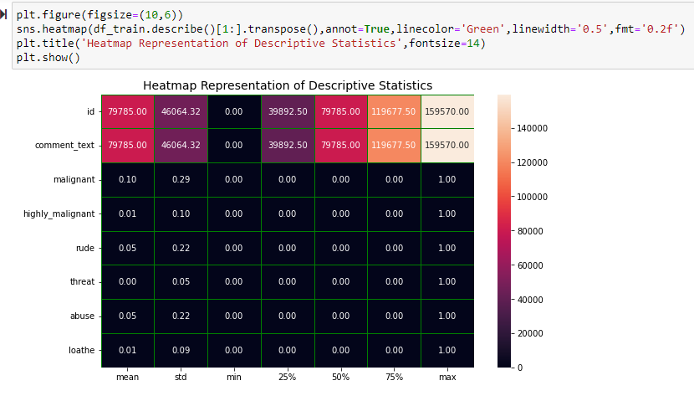
Data Visualization

Slide 10
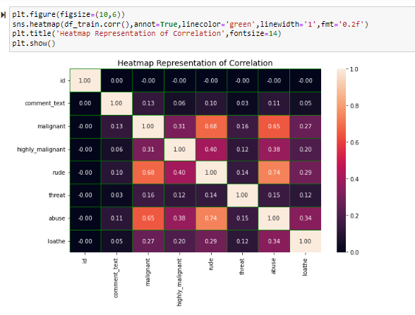
Data Visualization

Slide 11
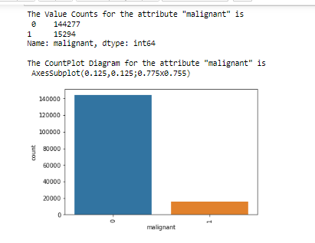
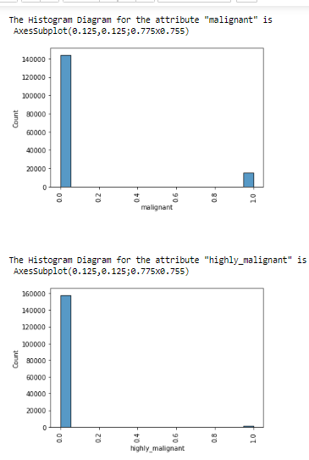
Data Visualization

Slide 12
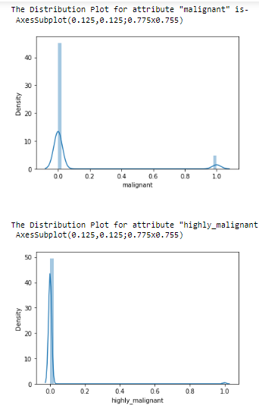
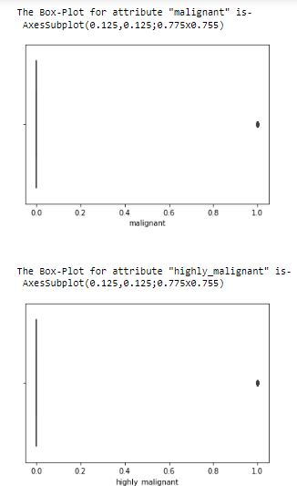
Data Visualization

Slide 13
Interpretation of the Results
989 comments are highly malignant as they are abusive and rude both.
618 comments are not highly malignant but they are abusive, rude and loathe all together.
317 comments those are not malignant are of rude type.
134 comments are abusive and loathe both.
56 comments are not highly malignant but they are rude, abusive, loathe and threat all together.
41 comments are not rude, abusive, loathe and threat all together but they are malignant and highly malignant comments.

Slide 14
Model’s Dashboard
Top 3 Models
Classification Models | Testing Accuracy (in %) | ROC AUC Score (in %) | F1-Score (in %)
Gaussian NB | 80 | 80 | 80
Gradient Boosting Classifier | 79 | 74 | 79
K Neighbors Classifier | 73 | 69 | 73
Random Forest Classifier | 62 | 60 | 62
Decision Tree Classifier | 61 | 64 | 61
Ada Boost Classifier | 52 | 52 | 52
Last 3 Models

Slide 15
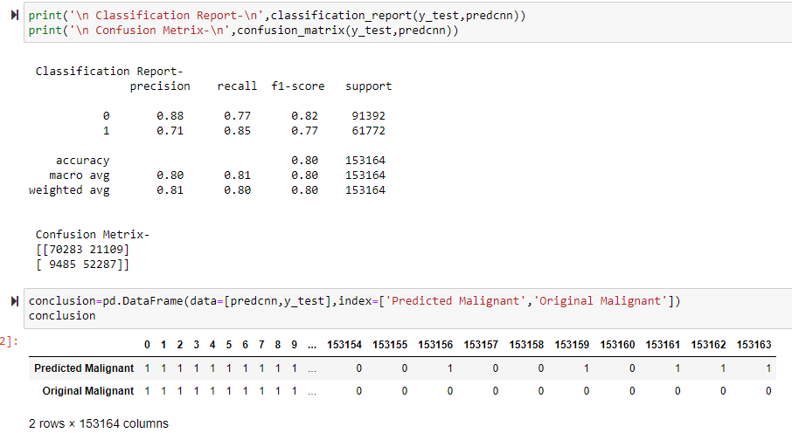
Finalized Classification Model
I’ve tested 6 different model and the best model that I got is ‘Gaussian Naive- Bayes’ having 80% of testing accuracy, F1-score and roc_auc score each.

Slide 16
Conclusion -
As we can see above all the models, Gaussian Naive Bayes model seems perfect one as compare to all as the testing accuracy score is 80%, F1 score is 80% and AUC ROC score is of 80% which is best as compare to other models; as ROC AUC Score is 0.80 which is greater than 0.6 of threshold value and it indicates that out of 100, 80 times model is predicting the right class and it is still a great accuracy. As we can see in the conclusion portion in the project itself we have got almost same value in prediction column as compare to original column. So we can say that this model has a great accuracy in predicting the malignant comments.

Slide 17


Thank You !
Ashutosh Mishra
ashutoshmishra11@outlook.com

